Slide 1
A Mathematical Theory of Communication
By C. E. Shannon

Slide 2
Introduction
History, Who is Shannon?
Basic Information Theory
What is information?
How to measure it?, Entropy
Grams
Stochastic Process for generating symbols / information
n-gram
Agenda

Slide 3
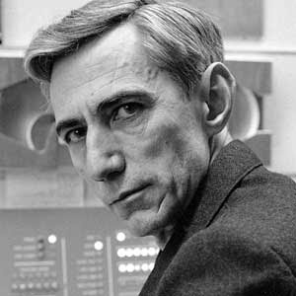
History
Claude Elwood Shannon, often referred to as the "father of modern digital communication and information theory," was a pioneering American mathematician, electrical engineer, and cryptographer. He made significant contributions to various fields, including information theory, cryptography, and computer science.
Shannon's most famous work, "A Mathematical Theory of Communication" (1948), laid the foundation for information theory.
Claude Elwood Shannon

Slide 4
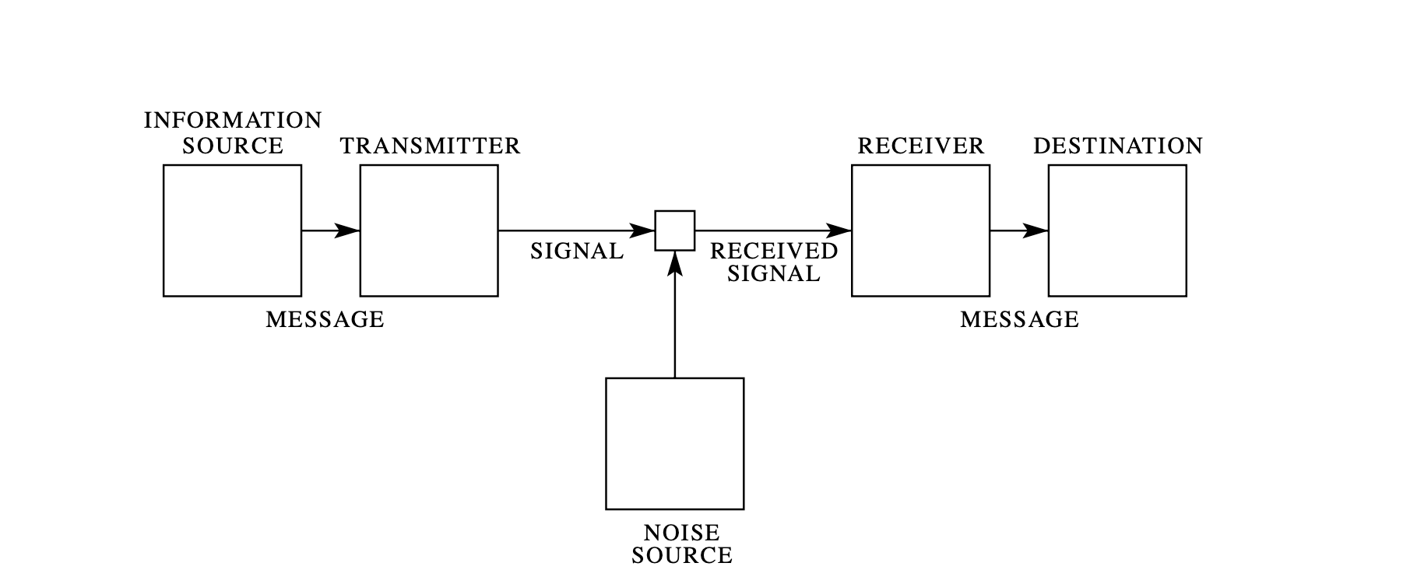
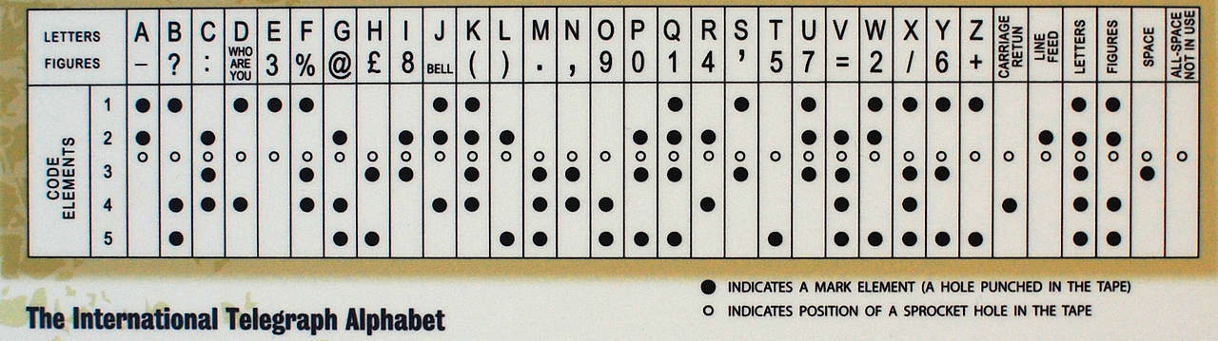


Slide 5
Information Theory
What is information ?
Semantic meaning of a message is irrelevant to its transmission. A message should be conceived as a sequence with statistical properties. It is the message’s statistics that could be captured and its coding minimized to allow for effective transmission.
Information is measured in bits, and one bit of information allows you to choose between two equally alternatives.
Basic laws of information
Upper limit for channel capacity
Noise
Encoding of data

Slide 6
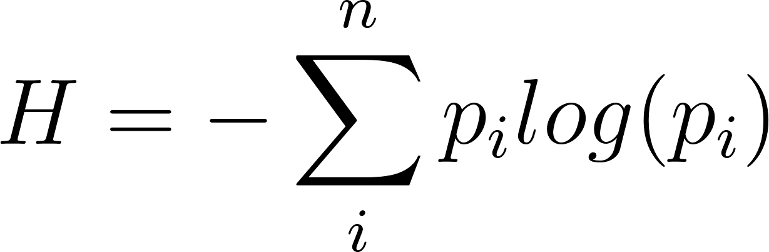
Measure of information

Slide 7
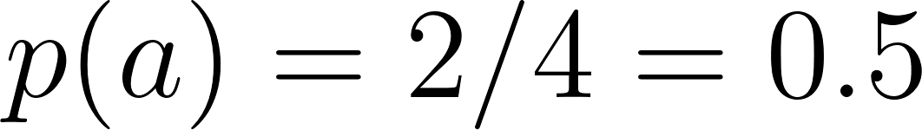
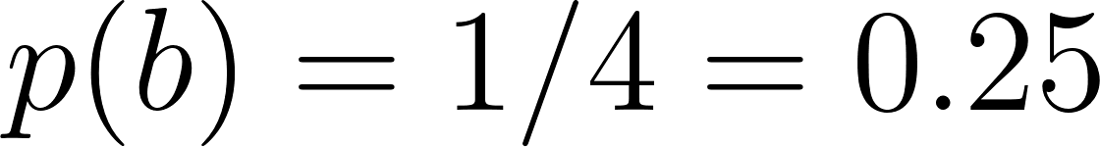
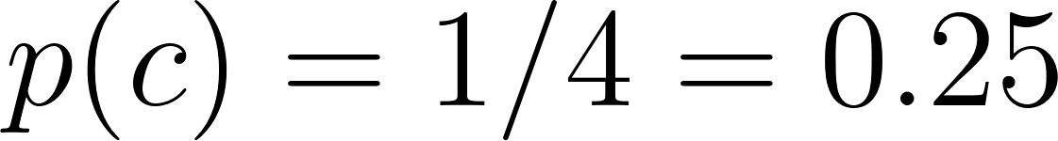
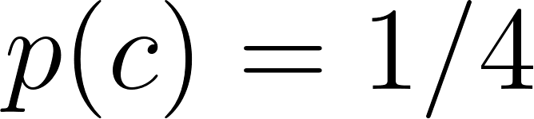
Consider a,b,c,
When, ,we need the following number of bits to represent them all.

Slide 8
Now, to determine the overall storage required
a occurs half and need 1 bit, so 0.5*1
b occurs quarter of the time and needs 2 bits, so 0.25*2
c occurs quarter of the time and needs 2 bits, so 0.25*2
In total (0.5*1) + (0.25*2) + (0.25*2) = 1.5 bits

Slide 9
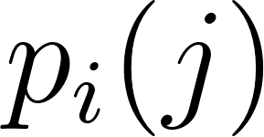


Stochastic Process for generating symbols / information
Consider 5 letters A B C D E, let the probabilities be 0.4,0.1,0.2,0.2,0.1.
A typical message constructed from this source is “AAACDCBDCEAADADACEDA E A D C A B E D A D D C E C A A A A A D.”
Transition Probabilities
The probability of is followed by letter

Slide 10
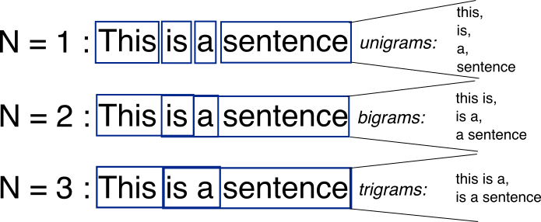
Image Source : Stackoverflow

Slide 11

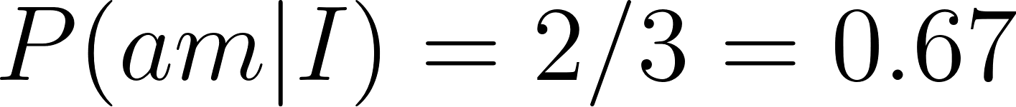
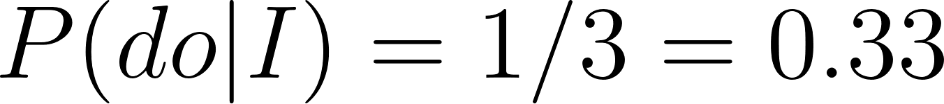
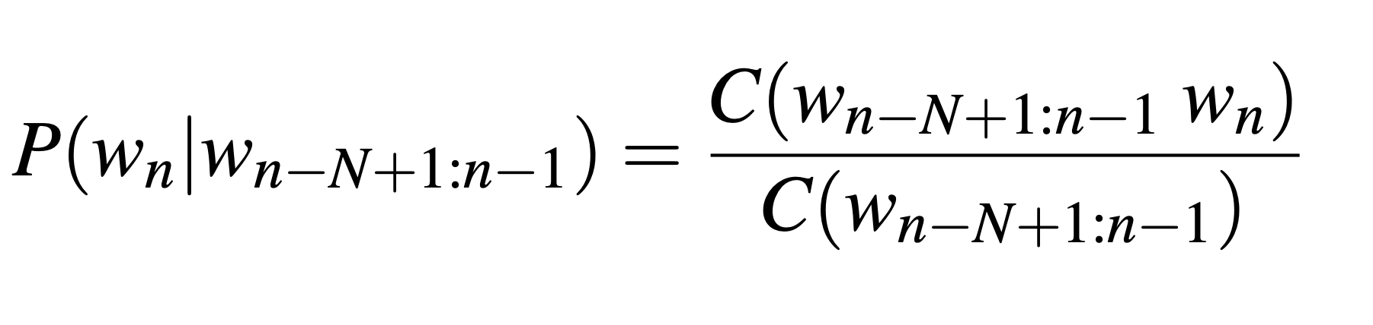
- gram
- grams is a sequence of n adjacent words or letters from the text corpus
<s> I am Sam </s>
<s> Sam I am </s>
<s> I do not like green eggs and hams </s>
Here are the calculations for some of the bigram probabilities from this corpus
For the general case of MLE n-gram parameter estimation:

Slide 12
- gram Applications
Sentiment analysis
Text classification
Text generation

Slide 13
Thank You

